Slide 1
Clustering NBA Players by Shooting Efficiency
Abhi Joshi

Slide 2
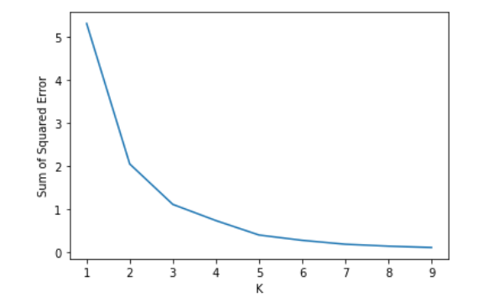
What is Clustering and why did I choose this?
Unsupervised Machine Learning Algorithm
Grouping a set of objects
K-means Clustering
Increased emphasis on 5-out principles

Slide 3
Process
Scrape data for shooting percentages of all NBA players from basketball reference
Data wrangling and cleaning
Try different values for k
Analyze and visualize data
Determine relevant features
Run K-Means algorithm to classify players into groups by shooting efficiency and capability
Find the most efficient lineups
Analyze correlation between spacing and offensive efficiency

Slide 4
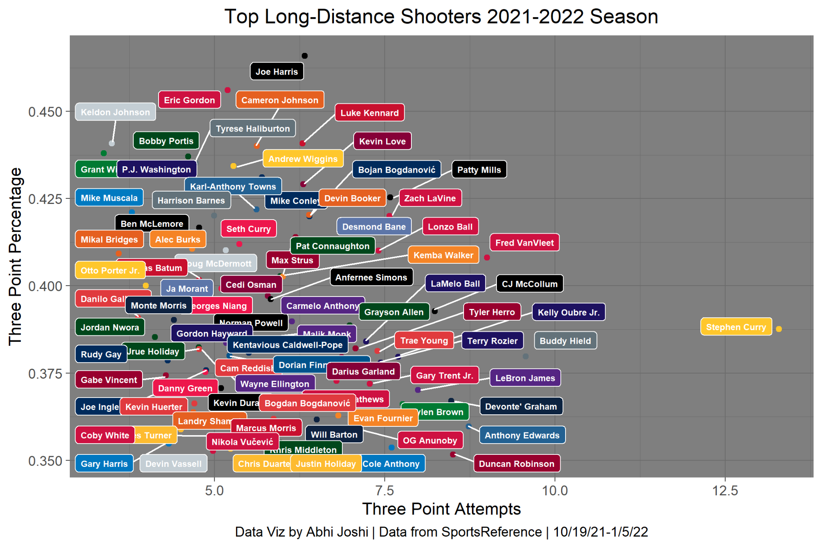
Scoring Process
Non-spacer(Below Average) = 0
Semi-spacer(Average) = 0.5
Spacer(Good or Great) = 1
Players played at least 20 games
4 Clusters

Slide 5
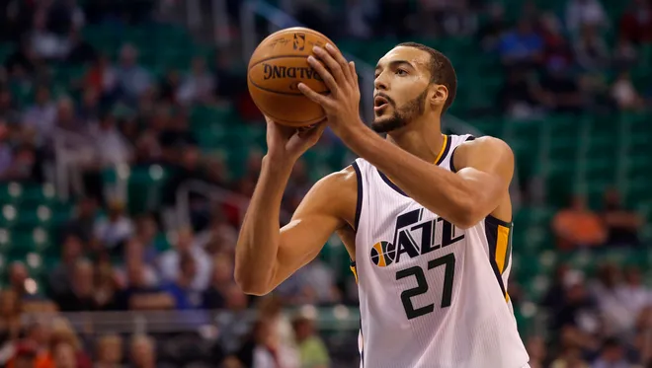
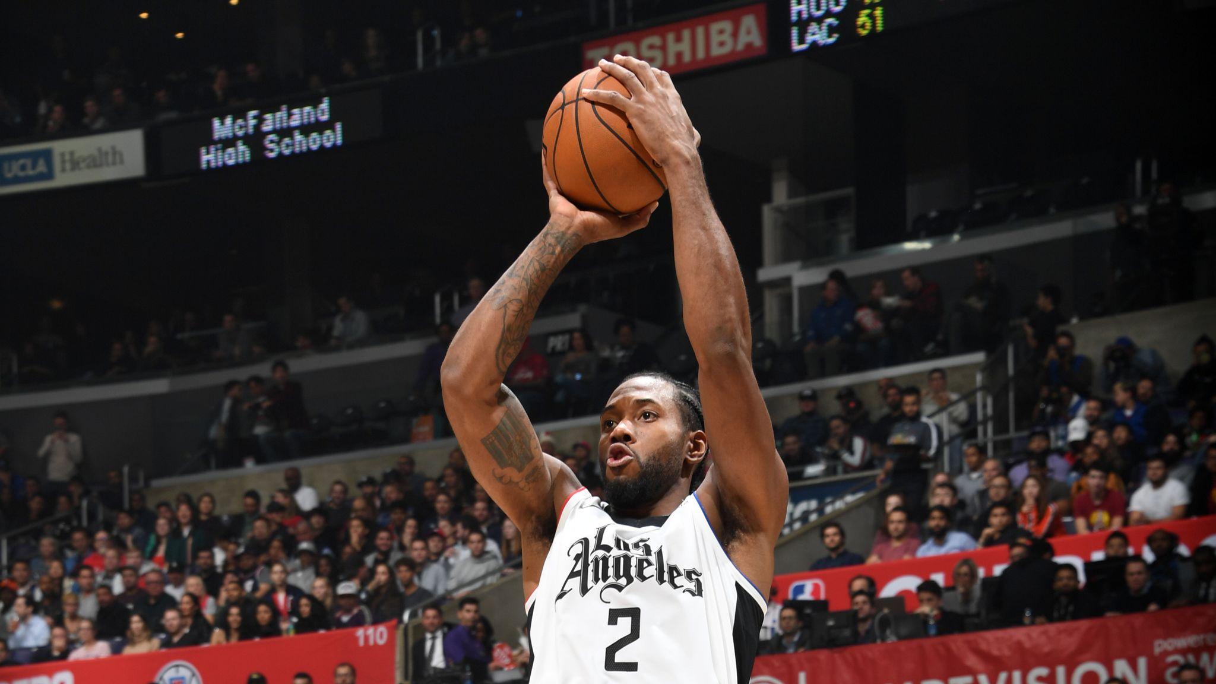
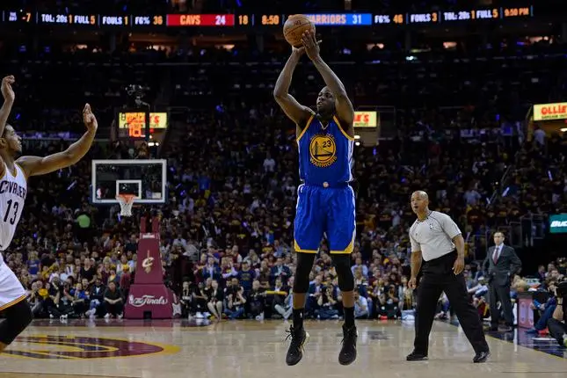
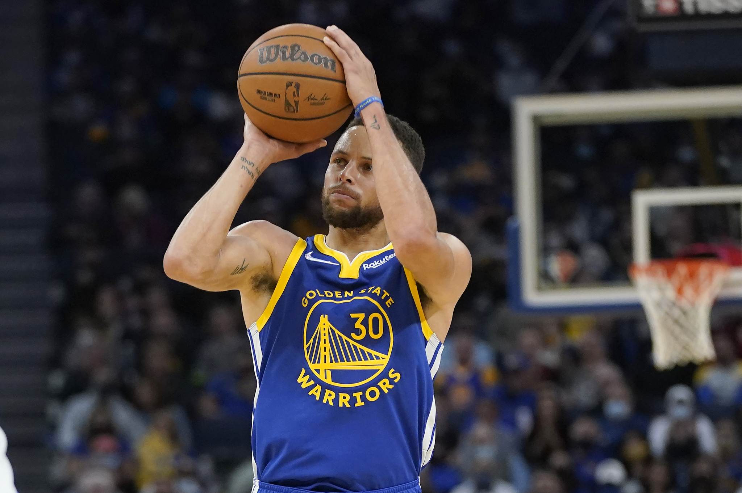
Top players in each group:
Below Average (0)
Ben Simmons
Rudy Gobert
Bam Adebayo
Steven Adams
DeAndre Ayton
Zion Williamson
Jarrett Allen
Clint Capela
Average (0.5)
Ja Morant
Joel Embiid
Jimmy Butler
Draymond Green
Russell Westbrook
Anthony Davis
Giannis Antetokounmpo
Good (1)
Kevin Durant
Jayson Tatum
Devin Booker
Kawhi Leonard
Zach LaVine
Chris Paul
LeBron James
Paul George
Great (1)
Stephen Curry
Damian Lillard
Seth Curry
Buddy Hield
Joe Harris
Gary Trent Jr.
D’Angelo Russell

Slide 6
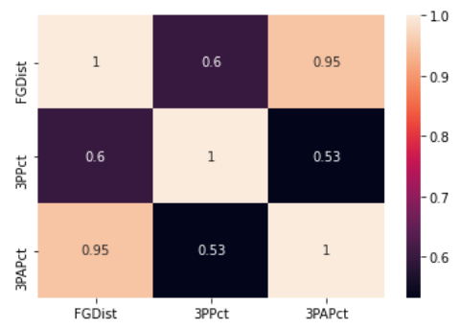
Key Statistics
Average Field Goal Distance(FGDist)
3-Point Percentage(3PPct)
3-Point Attempt Percentage(3PAPct)

Slide 7
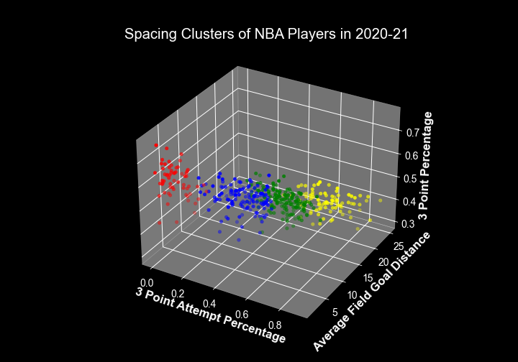
Model

Slide 8





Most Efficient Lineups
Highest offensive rating for most played lineups in the regular season for playoff teams from 2021
Team | Lineup | Spacing Score | Offensive Rating
 | Murray, Barton, Porter Jr. Millsap, Jokic | 4.5 | 124
 | Doncic, Richardson, Finney-Smith, Porzingis, Kleber | 5 | 123.7
 | Beverley, George, Leonard, Batum, Ibaka | 4.5 | 118.3
 | Lillard, McCollum, Powell, Covington, Nurkic | 4 | 118.1
 | Holiday, DiVincenzo, Middleton, Antetokounmpo, Lopez | 4 | 117.7

Slide 9





Least Efficient Lineups
Lowest offensive rating for most played lineups in the regular season for playoff teams from 2021
Team | Lineup | Spacing Score | Offensive Rating
 | Simmons, Curry, Green, Harris, Embiid | 3 | 117.7
 | Nunn, Robinson, Butler, Ariza, Adebayo | 3.5 | 116.7
 | Young, Huerter, Reddish, Collins, Capela | 3.5 | 114.4
 | Payton, Bullock, Barrett, Randle, Noel | 3 | 109
 | Westbrook, Beal, Mathews, Hachimura, Len | 2 | 104

Slide 10
References
https://www.basketball-reference.com/
https://www.nba.com/stats/lineups/advanced/?Season=2020-21&SeasonType=Regular%20Season
https://www.sportslogos.net/teams/list_by_league/6/National_Basketball_Association/NBA/logos/

